Slide 1




Weekly report: Load & Dynamics
Week number: 11
Date: 09/12/2025
Supervisor: Mr. Manjock
Group members: Md Aman, Arham Memon, Paresh Nakum
Presenter – Arham Memon
09/12/2025
Arham Memon
Optimus Syria

Slide 2
Agenda For Loads & Dynamics
OpenFAST With LiDAR
Simulation Directory
MExtreme Calculation
Final Working Procedure
Conclusion & Future Plan
Bibliography
09/12/2025
Arham Memon
Load & Dynamics Team/ Optimus Syria

Slide 3
OpenFAST with LiDAR Simulation
OpenFAST v3.0 is applicable with LiDAR Simulation.
A Total of 6 Design Load Cases will be used in this Optimus Syria Project.
DLC | Wind Type
1.2 Power Production | NTM
2.3 Power Production + Fault | NTM
4.2 Normal Shut down | EOG
5.1 Emergency Stop | NTM
6.1 Parked & Idling | EWM
7.1 Parked + Fault | EWM
09/12/2025
3
Arham Memon
Load & Dynamics Team/ Optimus Syria

Slide 4
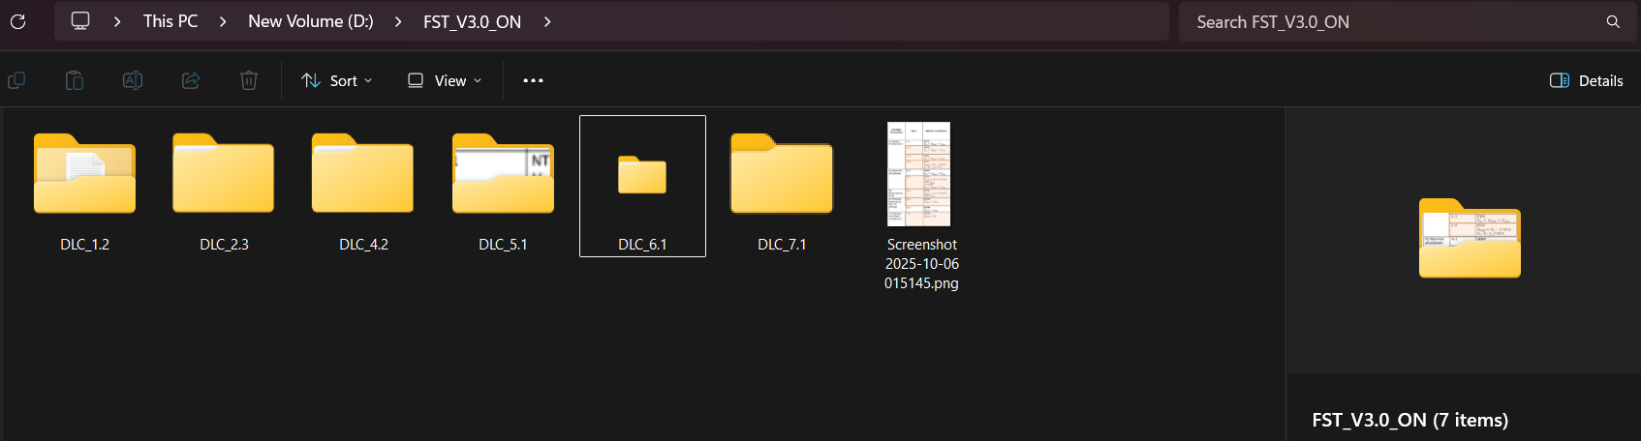
OpenFAST Working Directory
As of now DLC 1.2, DLC 5.1, DLC 6.1 all simulation updated with Optimus Syria Turbine, others are being updated.
All file parameter updated like twr.dat, bld.dat, aerofoil, aerodyn.dat except controller.
Updation time with controller by week 12.
09/12/2025
4
Arham Memon
Load & Dynamics Team/ Optimus Syria

Slide 5
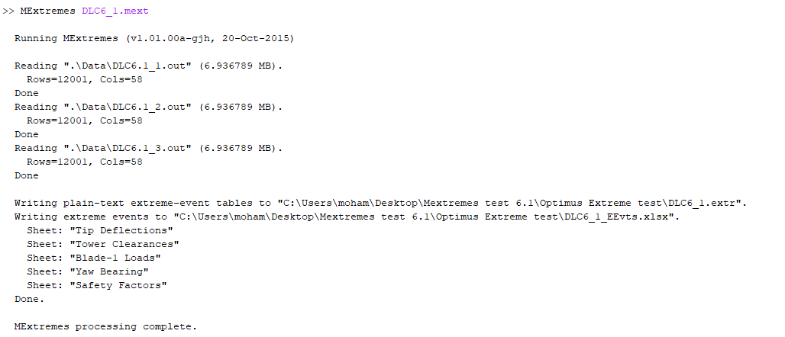
MExtreme
Matlab Extreme used to calculate extreme values of openFAST out file.
Helps to locate maxima & minima with different rand seed at same wind speed of one DLC case.
Example of DLC 6.1 with 3 different randseed at 42.5m/s wind speed
09/12/2025
5
Arham Memon
Load & Dynamics Team/ Optimus Syria

Slide 6
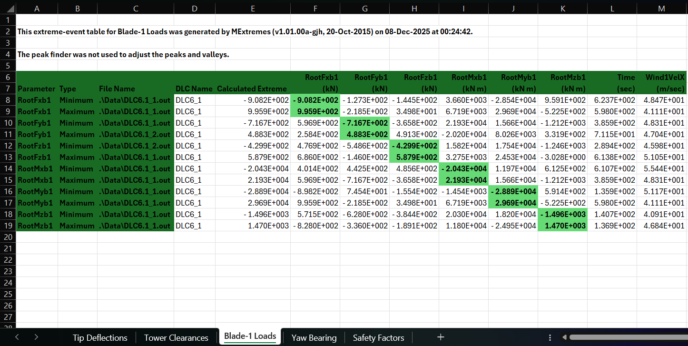
Mextremes Calculation
Extreme Point Throughout all out file of DLC 6.1
Considrations before generating Mextremes for DLC 6.1:-
Turbine Configured according Optimus Syria, All aerodata, structure data properties configured except Controller.
Safety Factors are considered during Mextremes calculations.
09/12/2025
6
Arham Memon
Load & Dynamics Team/ Optimus Syria

Slide 7
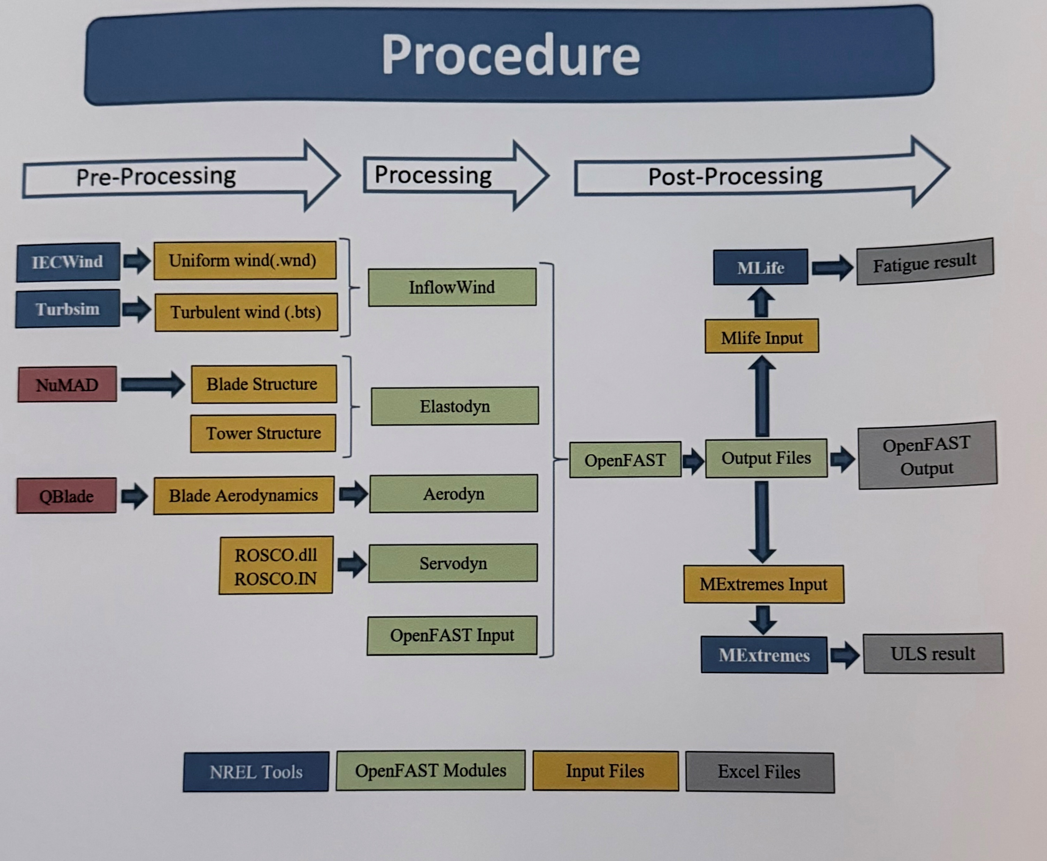
Final Working Procedure
Done Done In Progress (Max 1week)
Source: Optimus Oceanus
09/12/2025
7
Arham Memon
Load & Dynamics Team/ Optimus Syria

Slide 8
Conclusion & Future Plan
In the last week we
Mextremes tests initated
Provided forces and moments at different section of turbine to other teams with time series graph.
DLCs are configured according to Syrian Turbine.
In the next week
Work with controller group for controller file.
Update Remaining DLCs.
Work With Final Post Processing task (Mextremes).
09/12/2025
8
Arham Memon
Load & Dynamics Team/ Optimus Syria

Slide 9
References
Load Reports of the OPTIMUS Ocenaus
Standard, DNVGL-ST-0376 – Edition December 2016
TurbSim, OpenFAST_v3.0 & NREL 5 MW
MatLAB 2011b, MExtremes
09/12/2025
9
Arham Memon
Load & Dynamics Team/ Optimus Syria

